Slide 1
SPAR Cost Share 101
Office of Financial Compliance for Research
Navigating Labor Distribution & Cost Sharing Percentages

Slide 2
Types of Cost Sharing
Cost Sharing refers to costs associated with a sponsored project that are not funded by the sponsor. We categorize the types of cost sharing in the SPAR application by the following codes:
K – indicates that a portion of the actual effort allocated to this project is to be cost shared to a Career Development, or K-Award.
M – indicates Mandatory Cost Sharing, also referred to as MCS. Mandatory cost sharing is statutorily required based on a sponsor-mandated salary cap restrictions.
V – represents voluntary, committed cost sharing. This occurs when named personnel commit a certain level of effort to the project and the award budget provides salary support at a lower level.
O – represents other, voluntary uncommitted cost sharing. This may occur in the case of a no-cost extension when effort continues but no more salary support is available.
N – Not applicable. This code is used to indicate that there is no cost sharing associated with this sponsored project. This code is also to be used for all non-entity 05 accounts.

Slide 3
Cost Share terms
Cost Share Recipient Account – The institutional (entity 02 or 04) account or K-award account that absorbs the project costs not funded by the sponsor.
Cap Eligible Employee – An employee identified by the SPAR application whose annualized salary exceeds the DHHS salary cap.
Cap Account – A sponsored project account identified by the SPAR application as being subject to a sponsor-imposed salary cap.
Mandatory Cost Sharing (MCS) – That portion of an employee’s salary that exceeds the sponsor imposed salary restriction and must be cost shared to an institutional account as required by the agencies of the DHHS.
Regular Line - Any of the lines entered in the Effort Reporting and Distribution section of the SPAR screen which include Actual and Distributed effort percentages.
Joint Line - Any of the lines entered in the Cost Sharing for Effort Reporting section of the SPAR screen which identify cost sharing relationships and the percentage of effort to be cost shared. Only Entity 05 accounts may be entered on joint lines.

Slide 4
Situations requiring Mandatory cost sharing
DHHS Mandated Salary Cap (Mandatory Cost Sharing)
The length of a faculty member’s appointment must be considered when determining who is subject to the salary cap restriction, as follows:
Length of Appointment Salary Limit
12-Month $179,700
10-Month $149,750
9-Month $134,775
8-Month $119,800
Part-time positions must be adjusted to reflect salary at 1 Full Time Equivalent for comparison to salary cap limits.
Any salary paid over the limit must be cost shared to an institutional account.

Slide 5
Example of cap eligible calculation
Scenario – Jane Doe:
8-Month Appointment
Part-time, 50% Full Time Equivalent (FTE)
Institutional Base Salary, ‘IBS’ (contract salary + any administrative supplements) = $60,000
Monthly salary
$60,000 / 8 = $7,500
Annualized salary
$7,500 X 12 = $90,000
Annualized salary adjusted to 1 FTE
$90,000 / .50 = $180,000

Slide 6
Allowable salary distribution
% of Actual Effort allowable on sponsored project
Current Cap Limit / Annualized Salary@1FTE
$179,700 / $180,000 = 99.83%
This means that only 99.83% of whatever level of Actual Effort spent on a project can be charged to the project account.
In this example, if this employee has 20% Actual effort for this project on the SPAR, the allowable, or distributed, effort is 20% X 99.83% or 19.96%.
The difference of .04% is the required mandatory cost shared percentage.

Slide 7
MCS calculation template
A template has been developed and is available on the Financial Compliance for Research website to assist you in calculating MCS.
Enables you to determine MCS at various levels of effort.
Calculates the monthly/annual cost of required cost sharing.
Can be used at the proposal phase to project budgetary impact.
Requires data entry of compensation information in fields highlighted in blue. Error messages in the calculated columns will disappear as information is entered.
The MCS Template is accessible at: www.cfo.pitt.edu/fcr
An example of this template is provided on the next page.

Slide 8
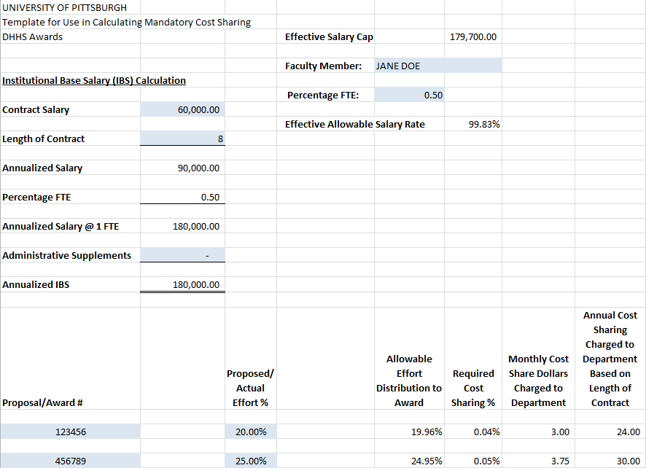

Slide 9
Situations requiring voluntary cost sharing
Individual devotes more effort to a project than there is funding to cover salary. (Voluntary, Committed Cost Sharing)
Dr. Smith spends 30% of his time on sponsored project A.
Salary budget of project A provides only 20% of Dr. Smith’s salary.
SPAR must reflect 30% actual effort – 10% cost sharing to institutional account & 20% distributed effort to sponsored project A.
Actual Effort 30
Level of Sponsor Funding - 20
Voluntary Cost Share Requirement 10

Slide 10
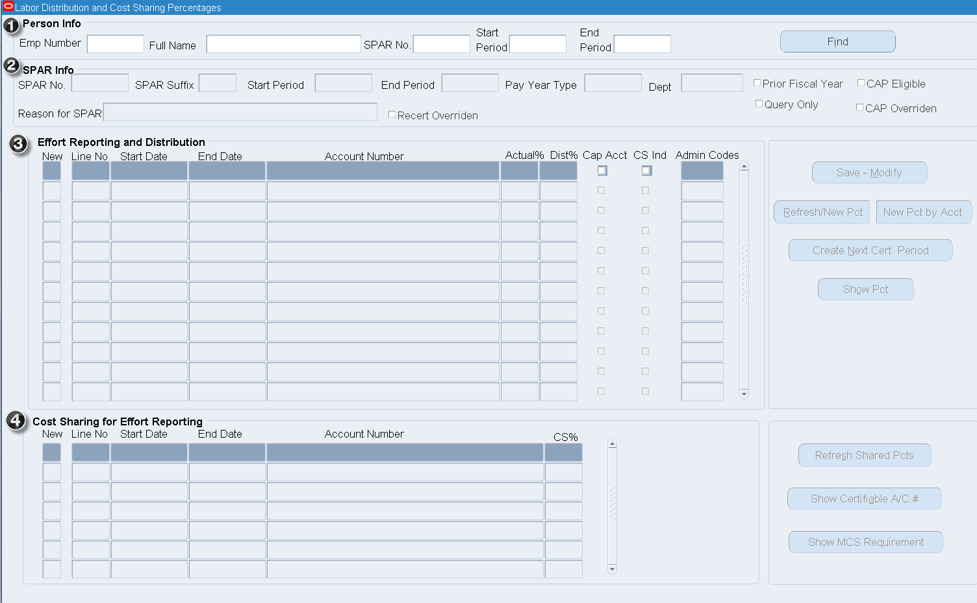
Labor Distribution & Cost Sharing Percentages

Slide 11
Example of the Functionality of the Dist% Column
Effort Reporting and Distribution Increase/ Related
Line # Account # Actual% Dist% (Decrease) Joint #
1 02.22298.5100.00000.000000 10 37 27 1.01+1.02
2 05.22298.5100.00000.123456 50 35 (15) 1.01
3 05.22298.5100.00000.234567 40 28 (12) 1.02
100 100 0
Cost Sharing for Effort Reporting CS%
1.01 05.22298.5100.00000.123456 15
1.02 05.22298.5100.00000.234567 12
27
The cost share recipient account on line 1 receives the cost shared effort on related joint lines 1.01 and 1.02. The system adds the CS% from lines 1.01 and 1.02 to the Actual% on line 1 (15+12+10=37).
The sponsored projects on lines 2 and 3 have related cost shared effort subtracted from Actual% to determine Dist%. For example, sponsored project on line 2 has Actual% of 50% less the related CS% on line 1.01 of 15% resulting in 35% Dist%.
Note: Figures in blue do not appear on the SPAR screen. They are included here for training purposes only.

Slide 12
Cost share basic rules
Following are some basic rules for cost sharing in the on-line SPAR:
Three lines are required for every cost share relationship
The regular sponsored project line
The cost share recipient line (institutional account or K-Award)
The joint line
The Start and End dates on all three lines within the cost share relationship must be consistent.
A cost share recipient line may be related to more than one sponsored project but all related sponsored project regular and joint lines must have Start and End dates consistent with the recipient line.

Slide 13
Cost sharing a single grant, for less than the entire period of performance

Slide 14
Cost sharing a single grant, with intermittent CS% during the period of performance

Slide 15
Cost sharing two grants to one department account

Slide 16
Directions for modifying two grants to one Department account.

Slide 17
Summary of key cost sharing principles
Every cost share relationship requires three lines (recipient, project and joint). Start and End Dates must be consistent on all three lines.
A cost share recipient line may be related to more than one project account but each set of project and joint lines must have Start and End Dates consistent with the recipient line.
Voluntary cost sharing lines for Non-Cap Eligible employees may have different values for Actual% and CS%. Actual% cannot be less than CS%.
Voluntary cost sharing lines for Cap Eligible employees on Cap Accounts must have equal values for Actual% and CS%.
Voluntary cost sharing lines for Cap Eligible employees for non–Cap Accounts may have different values for Actual% and CS%. Actual% cannot be less than CS%.
Effort that is 100% voluntarily cost shared must have a regular sponsored project line to record Actual effort. The offsetting cost share entry will create a zero Distributed percentage. (see #1 above)
Only Entity 05 accounts may be entered in Joint lines.

Slide 18
System Availability
Access to the new on-line SPAR screen through the PRISM system will begin on September 10, 2012.
During the time periods noted below, SPAR users will have access to all inquiry functions and view only access to the on-line SPAR screen. SPAR modification functionality will not be available during these times.
Nightly from 9:30 p.m. until midnight to accommodate daily processing and updates to related applications.
During the month-end closing processes, beginning at 5:00 p.m. on the 2nd working day of each month until 6:00 a.m. on the 5th working day of the month.
Non-routine system maintenance will be performed as required and may result in unscheduled SPAR application restrictions.

Slide 19
Contact Information
Office of Financial Compliance for Research
2502B Cathedral of Learning
Pittsburgh, PA 15260
Website: www.cfo.pitt.edu/fcr
Email: sparhelp@cfo.pitt.edu

Slide 20
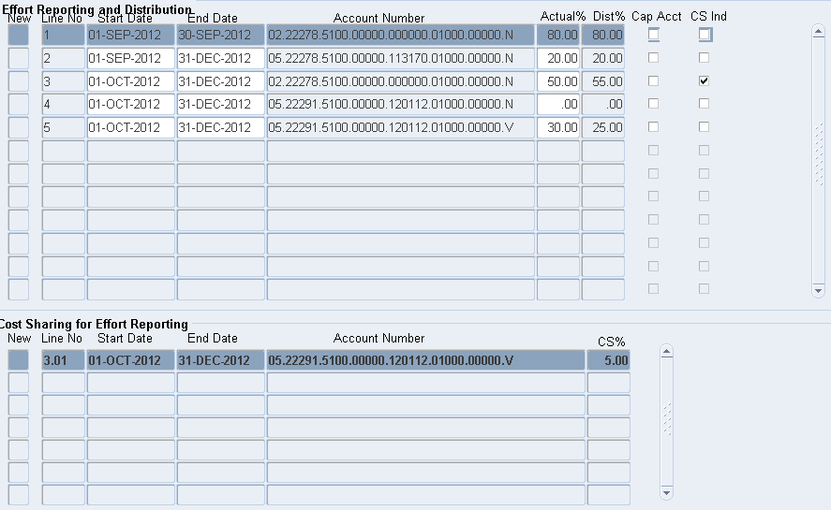
Example 1: Faculty a spar01

Slide 21
Example 1 details
Facts regarding Faculty A:
Not Cap Eligible.
Initial distribution: 80% to departmental account and 20% to project 113170 for the entire period of performance, September through December.
New sponsored project, 30% of his effort beginning October 1st.
Steps to update his SPAR for new award:
Change the End Date on line 1 to Sep 30 to accommodate the change in departmental effort going forward due to the effort devoted to the new award.
Create a new departmental account line. (See instructions for copying account numbers on page 26 of course materials.) Click the New box to the left of line 3.
In the pop-up box, enter the account number or complete the copy function. Modify the Start Date to October 1 and End Date to December 31. Enter Actual effort of 50%. This represents the former department effort of 80% less the effort devoted to the new sponsored project of 30%. Click OK to transfer the data entered to the new SPAR line 3.
Create the new sponsored project line. Click the ‘New’ box on the next line. The Dates in the pop up box are populated with dates from the preceding line. Confirm that dates are October 1 and December 31. Enter the sponsored project account number and 30% Actual effort. Click OK to transfer the data entered to the new SPAR line 4.
Click Refresh/New Pct to confirm that the SPAR is in balance, then Save.

Slide 22
Example 1 details (con’t)
New Award Facts:
Committed effort 30%
Salary support 25%, requiring 5% Voluntary Cost Sharing
Steps to update his SPAR to recognize Voluntary Cost Sharing:
Line 4 saved with ‘N’ cost share code. Cannot modify saved account numbers. Change Actual effort to 0%.
Click ‘New’ box on line 5. Verify that dates match former line 4. Enter sponsored project account # with ‘V’ cost share code. Enter 30% Actual effort. Click OK.
Highlight line 3 to identify recipient account. Click ‘New’ box in Cost Sharing for Effort Reporting section to link recipient account to joint line. In pop-up box, confirm dates, enter account # with ‘V’ code and 5% cost shared %. Click OK.
Click Refresh/New Pct button to confirm SPAR is in balance. Save.

Slide 23
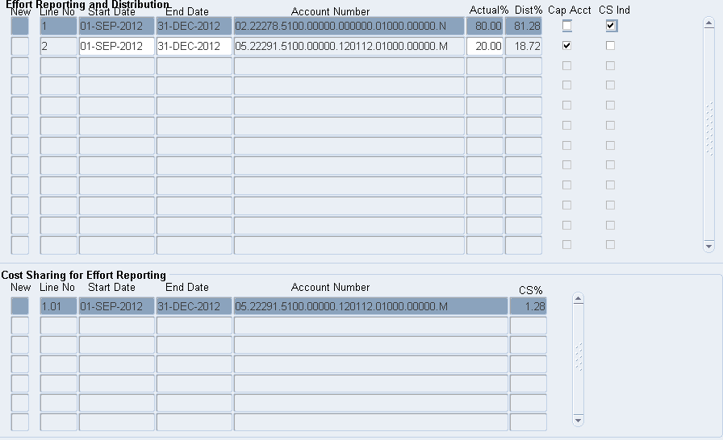
Example 2: faculty e spar01

Slide 24
Example 2 details
Facts regarding Faculty E SPAR 01:
Cap Eligible.
Initial distribution: 100% to departmental account for the entire period of performance, September through December.
New DHHS sponsored project, 20% of his effort beginning September 1st.
Steps to update his SPAR for new award:
Click on Actual effort % field on line 1 and change from 100% to 80% to allow for grant effort.
Click on ‘New’ box on line 2 to enter regular sponsored project line. Confirm dates are Sep 1 – Dec 31, enter 05 account number, and 20% actual effort, OK.
Check in Cap Acct box indicates subject to MCS. Change cost share code on line 2 from ‘N’ to ‘M’.
Highlight the recipient line 1 to establish the cost share relationship and click the ‘New’ box in the Cost Sharing for Effort Reporting section. Pop-up box dates agree with recipient dates, enter 05 account number from line 2 with ‘V’ cost share code. Place cursor in CS% field and click Calc MCS button. Refresh and Save.

Slide 25
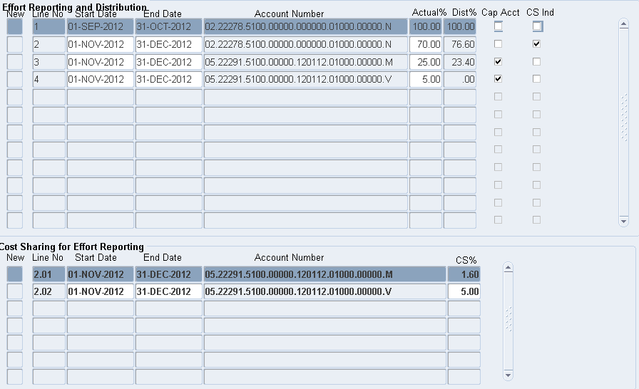
Example 3: faculty e spar02

Slide 26
Example 3 details
Facts regarding Faculty E SPAR 02:
Cap Eligible.
Initial distribution: 100% to departmental account for the entire period of performance, September through December.
New DHHS sponsored project, 30% effort beginning November 1st, MCS required.
Steps to update his SPAR for new award:
Click on line 1 End Date and change to Oct 31. This is necessary to start new department line with dates consistent with DHHS sponsored project.
Create new dept/recipient line. Click ‘New’ box on line 2. In pop-up box enter Start Date of Nov 1 and End Date of Dec 31, department account #, and 70% Actual effort. Click OK.
Create sponsored project line. Click ‘New’ box on line 3. In pop-up, confirm dates to be same as recipient line, enter project account # with ‘M’ cost share code since MCS applies, and Actual effort of 30%. Click OK.
Create joint line. Highlight recipient line 2 to establish the cost share relationship and click the ‘New’ box in the Cost Sharing for Effort Reporting section. Pop-up box dates agree with recipient dates, enter 05 account number from line 3 with ‘M’ cost share code. Place cursor in CS% field and click Calc MCS button. Refresh and Save.

Slide 27
Example 3 details (con’t)
New Budget Information:
Committed effort 30%
Salary support 25%, requiring 5% Voluntary Cost Sharing
Steps to update his SPAR to recognize Voluntary Cost Sharing:
The Voluntary Cost Sharing requires a ‘V’ cost share code. Current sponsored project line requires ‘M’ code to satisfy MCS requirement. Need a second line to reflect Voluntary Cost Sharing.
Click ‘New’ box on line 4. Verify that dates match recipient line 2. Enter sponsored project account # with ‘V’ cost share code. Enter 5% Actual effort. Click OK.
Place cursor in Actual% field on line 3 and change value to 25%. Reduction is necessary to properly state Actual effort for project when totaling lines 3&4.
Highlight line 2 to identify recipient account. Click ‘New’ box in Cost Sharing for Effort Reporting section to link recipient account to joint line. In pop-up box, confirm dates, enter account # with ‘V’ code and 5% cost shared %. Click OK, data transferred to new line 2.02.
Click Refresh/New Pct button to confirm SPAR is in balance. Save.

Slide 28
Instructions for copying account #
To copy an account number to a regular SPAR line:
Highlight the account number to be copied, Press Ctrl-C
Click ‘New’ box on next available line in Effort Reporting and Distribution section
Place cursor in account number field in pop up box, Press Ctrl-V
To copy an account number to a joint SPAR line:
Highlight the account number to be copied, Press Ctrl-C
Highlight the cost share recipient line
Click ‘New’ box on the next available line in the Cost Sharing for Effort Reporting section
Place cursor in account number field in pop up box, Press Ctrl-V

